Slide 1
Unit III: Overview of Medical Mycology Important Fungal Diseases – Superficial, Subcutaneous, Systematic and Opportunistic Mycosis
Sweta Sushmita Tigga
Department of Microbiology
DSPMU, Ranchi.
Lecture- M.Sc Microbiology Semester III

Slide 2
WHAT IS MEDICAL MYCOLOGY?
Fungi
MEDICAL MYCOLOGY
Deals
Human Diseases
(Fungal diseases)
Mycoses
Medical mycology is the discipline that deals with the fungi that causes human disease. These fungal diseases, known as Mycoses.

Slide 3
Types of Fungal Diseases
Fungal Diseases are divided into classes based on their invasiveness
Superficial
Subcutaneous
Systematic and Opportunistic Mycosis

Slide 4
Mycoses
Mycoses that cause superficial infections of the epidermis, hair, and nails, are called cutaneous mycoses
Mycoses that penetrate the epidermis and the dermis to infect deeper tissues are called subcutaneous mycoses.
Mycoses that spread throughout the body are called systemic mycoses.
Most patient who develop opportunistic infections have serious underlying diseases and compromised host defenses, and also infect immunocompetent individuals.

Slide 6
Superficial Mycoses
Infections of epidermis, hair and nail called cutaneous mycoses
collectively these pathogens are called dermatophytes.
Not serious health concerns

Slide 7
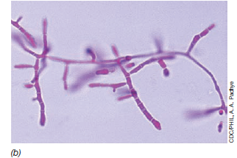
Superficial Mycoses
Fig. Pathogenic fungi- Trichophyton spp. Mycelia and conidia.

Slide 8
Superficial Mycoses
Fungi such as Trichophyton (figure 32.1b) cause infections of the feet (athlete’s foot) and other moist skin surfaces, and are quite common (figure 32.3a). These infections cause flaking and itchy skin and are easily transmitted by the cells or spores of the pathogen present in contaminated shower stalls, gymnasium and locker room floors, contaminated shared articles such as towels or bed liners, or from close person-to-person contact.
Related surface mycoses include “jock itch”, an itchy infection of the groin, skin folds or anus and ringworm.
Ringworm is a fungal infection, typically localized to the scalp or the extremities; the infection causes hair loss and inflammation

Slide 9
Superficial Mycoses
Treatment-
antifungal creams or liquid aerosols,
prophylactic application on a long term basis may be necessary if constant exposure to the pathogen.

Slide 10
Subcutaneous mycoses
Subcutaneous mycoses that penetrate the epidermis and the dermis to infect deeper tissues.
Subcutaneous mycoses are fungal infections of deeper layers of skin than those of the superficial mycoses
Treatment- Both sporotrichosis and chromoblastomycosis can be treated with oral administration of azoles.

Slide 11
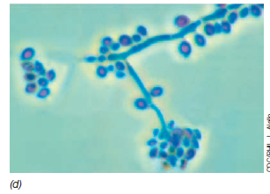
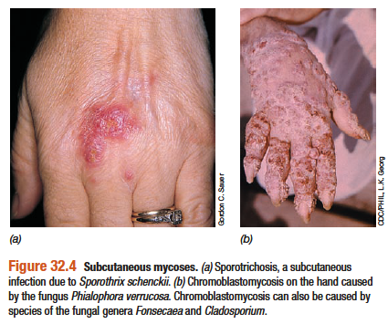
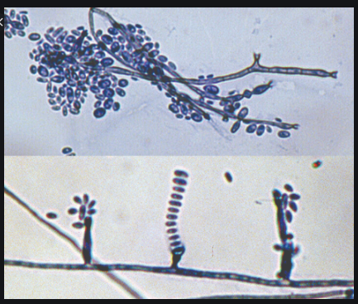
Subcutaneous mycoses
Figure 32.1 Pathogenic fungi – (d) Sporothrix schenckii mycelia and condia
Fig – Pathogenic Fungi- Phialophora verrucosa

Slide 12
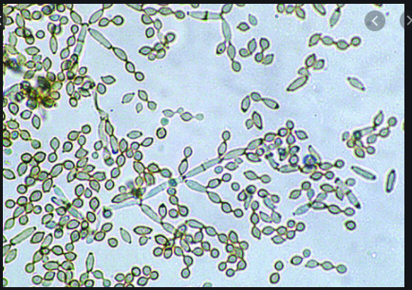
Subcutaneous mycoses
Fig- Fonsecaea, also causes Chromoblastomycosis
Traumatic injury
Fig- Cladosporium, also causes Chromoblastomycosis

Slide 13
Systemic Mycoses
Systemic Mycoses that spread throughout the body are called systemic mycoses.
Systematic fungal pathogens normally live in soil, and humans become infected by inhaling airborne spores that later germinate and grow in the lungs. From there the organism migrates throughout the body, causing deep-seated infections in the lungs and other organs and in the skin.

Slide 14
Systemic Mycoses
Histoplasmosis (Figure 32.5a) is caused by Histoplasma capsulatum (Figure 32.1e)
Coccidiomycosis (Valley fever) (Figure 32.5d) is caused by Coccidiodes immitis (Figure 32.1f).
Cryptococcois (Figure 32.5c), caused by the dimorphic fungi Crptococcus neoformans (Figure 32.1a), can occur in virtually any organ of the body and is the major mycosis seen in HIV/AIDS patients.

Slide 15
Systemic Mycoses
Itraconazole is one type of antifungal medication that’s commonly used to treat histoplasmosis. Depending on the severity of the infection and the person’s immune status, the course of treatment can range from 3 months to 1 year.
Specific antifungals (and their usual dosages) for treatment of coccidioidomycosis include amphotericin B, ketoconazole, fluconazole, and itraconazole .
Among the antibiotics used to treat cryptococcosis are the anti-fungal agents Amphotericin B, Flucytosine, and Fluconazole. These drugs may have serious side effects, so it is important for their use to be monitored carefully. Individuals with compromised immune systems, or under immune suppressive therapy, should be given prolonged drug treatment to prevent relapses.

Slide 16
Systemic Mycoses

Slide 17
Systemic Mycoses
Figure 32.1 Pathogenic fungi- (e) Histoplasma capsulatum mycelia and conidia and
(f) Coccidioides immitis conidia.

Slide 18
Systemic Mycoses
Figure 32.1 Pathogenic fungi. (a). Crytococcus neoformans yeast cells stained to reveal the capsule.

Slide 19
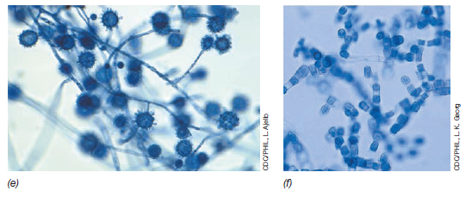
Thank you

